Slide 1
Theory Of Automata
Lecture 2
18/1/2017

Slide 2
Why study Theory of Computing?
What are the fundamental capabilities and limitations of computers?
What makes some problems computationally hard and others easy?

Slide 3
Question 1
What are the fundamental capabilities and limitations of computers?
Above question we will try to answer in this course is:
“What can be computed? What Cannot be computed and where is the line between the two?”

Slide 4
ANS 1=Computational Models
Which model is going to be select according to properties and limitation
  Formal definition of computation
Computational models
  Turing machines (= real computers)
  Simpler computing devices: finite state automata, push-down automata

Slide 5
Computability
What can and can not be computed?
Some problems have no algorithms
  Halting problem

Slide 6
Question 2
What makes some problems computationally hard and others easy?
  How quickly can a problem be computed?

Slide 7
Complexity
Many problems probably have no efficient algorithms
NP-hardness (= what can not be computed efficiently)
    factoring an integer into primes
    determining the shortest tour of given n cities

Slide 8
Why Study Automata Theory
Classify Problem
-Computability
-Complexity

Slide 9
Problem Type: P and NP
Classify into two kinds of problems:
Those that can be solved efficiently by computers
Those that can be solved in principles, but in practice take so much time that computers are useless for all but very small instances of the problem.

Slide 10
Problem Type: Computable Complex
Halting Problem (Turing):
Given a description of a program, decide whether the program finishes running or will continue to run, and thereby run forever. This is equivalent to the problem of deciding, given a program and an input, whether the program will eventually halt when run with that input, or will run forever.

Slide 11
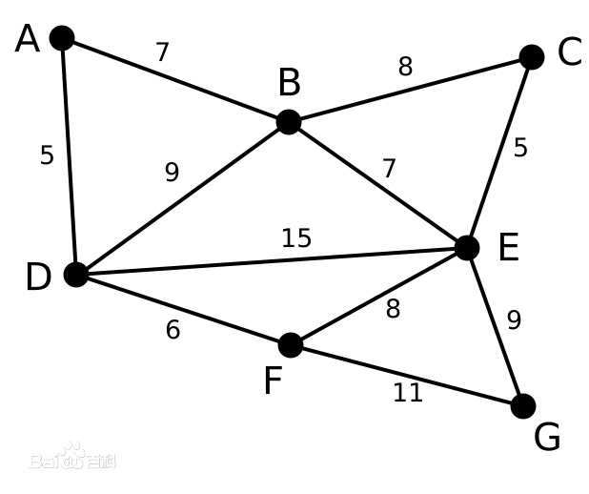
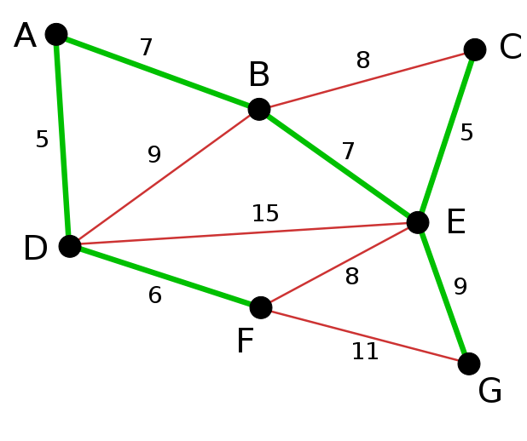
Problem Type: P-type
Kruskal Algorithm (Minimal spanning tree problem)

Slide 12
Problem Type: NP-type
Primarily Testing and Cryptography
There are a number of techniques based on RSA codes that enhance computer security, for which the most common methods in use today rely on the assumption that it is hard to factor numbers, that is, given a composite number, to find its prime factors.
Shor’s algorithm and Quantum Computation

Slide 13


Automata Theory helps:
Algorithm
Decidability
Efficiency (P vs. NP)
decidable
inefficient
efficient

Slide 14
So, Automata Theory
Automata theory deals with the definitions and properties of mathematical models of computation.
The theories of computability and complexity require a precise definition of a computer. Automata theory allows practice with formal definitions of computation

Slide 15
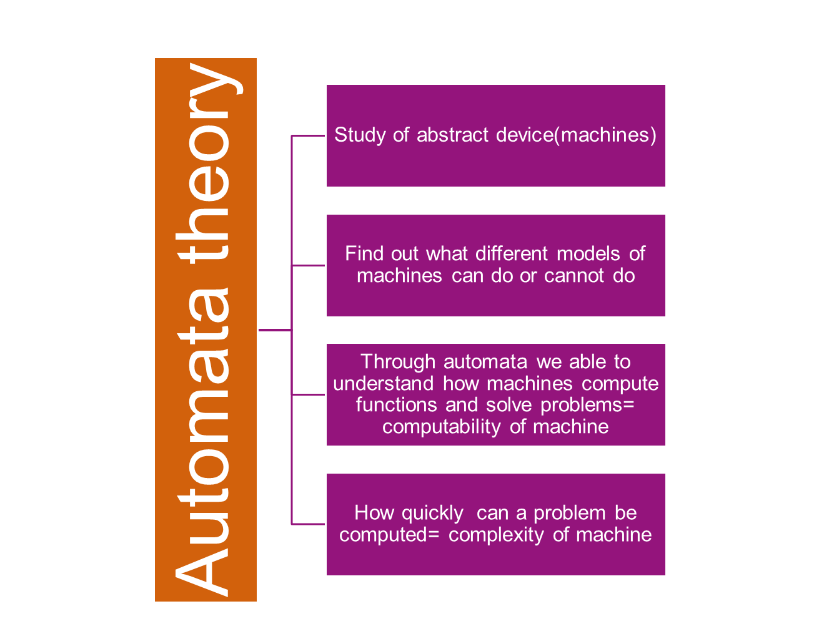

Slide 16
Solution models for computation
FINITE AUTOMATA | Devices with a finite amount of memory. Used to model “small” computers.
PUSH-DOWN AUTOMATA | Devices with infinite memory that can be accessed in a restricted way. Used to model parsers, etc.
TURING MACHINES | Devices with infinite memory. Used to model any computer.
TIME-BOUNDED TURING MACHINES | Infinite memory, but bounded running time. Used to model any computer program that runs in a “reasonable” amount of time.

Slide 17
Fundamentals
(Sets and Theory of Proofs)

Slide 18
Sets
A set is a collection of objects
  Order and repetition is irrelevant
  X = {1, 2, 3}
  Y = { } = ∅ ➔ Y is an empty set
The power set of X is the set of all subsets of X
  Ρ(X) = 2^{X} = { Y | Y ⊆ X}
  |Ρ(X)| = 2^{|X|}
Example X = {1, 2, 3}
  2^{X} = Ρ(X)={{},{1},{2},{3},{1,2},{1,3},{2,3}, {1,2,3}}

Slide 19
Sets
Proper Subset
if B is a proper subset of A, then all elements of B are in A but A contains at least one element that is not in B.
Example:
if A={1,3,5} then
B={1,5} is a proper subset of A.
C={1,3,5} is a subset of A, but it is not a proper subset of A since C=AC=A.

Slide 20
Set Example
Set of all vowels in the English alphabet:
V = {a,e,i,o,u}
Set of all odd positive integers less than 10:
O = {1,3,5,7,9}
Set of all positive integers less than 100:
S = {1,2,3,……..,99}
Set of all integers less than 0:
S = {…., -3,-2,-1}

Slide 21
Some Important Sets
N = natural numbers = {0,1,2,3….}
Z = integers = {…,-3,-2,-1,0,1,2,3,…}
Z⁺ = positive integers = {1,2,3,…..}
R = set of real numbers
R⁺ = set of positive real numbers
C = set of complex numbers.
Q = set of rational numbers (fractions)

Slide 22
Set-Builder Notation
Specify the property or properties that all members must satisfy:
S = {x | x is a positive integer less than 100}
O = {x | x is an odd positive integer less than 10}
O = {x ∈ Z⁺ | x is odd and x < 10}
A predicate may be used:
S = {x | P(x)}
Example: S = {x | Prime(x)}
Positive rational numbers:
Q⁺ = {x ∈ R | x = p/q, for some positive integers p,q}
(note ‘|’ means ‘such that’.)

Slide 23
Sets building
The ∈ symbol signifies membership (belong to):
  A ∈ X indicates that A is a member or element of the set X
  B ∉ X indicates that B is not a member or element of the set X
    Assume X = {1, 2, 3}, then
    1 ∈ X, but 4 ∉ X
Two sets are equal if they contain the same members (elements)
  If X = {1, 2, 3}, Y = {1, 2, 3}, and Z = {2, 3, 4}
  Then X = Y, but X ≠ Z, and so Y ≠ Z

Slide 24
Set Cardinality
Definition:
If there are exactly n distinct elements in S where n is a nonnegative integer, we say that S is finite.
Otherwise it is infinite.
Definition:
The cardinality of a finite set A, denoted by |A|, is the number of (distinct) elements of A.

Slide 25
Set Cardinality
Examples:
  |ø| = 0
  Let S be the letters of the English alphabet.
  Then |S| = 26
  |{1,2,3}| = 3
  |{ø}| = 1
  The set of integers is infinite.

Slide 26
Equivalence of Sets
Many important facts in language theory are of the form that two sets of strings, described in two different ways, are really the same set
To prove sets S and T are the same, prove:
  x is in S if and only if x is in T. That is:
    Assume x is in S; prove x is in T .
    Assume x is in T ; prove x is in S.

Slide 27
Operation on Sets
Assume X = {1,2,3} and Y = {2,4}
Union
  X ∪ Y = {z | z ∈ X or z ∈Y} = {1,2,3,4}
Intersection
  X ∩ Y = {z | z ∈ X and z ∈Y} = {2}
Difference
  X - Y = {z | z ∈ X and z ∉ Y} = {1,3}

Slide 28
Operation on Sets
Complement
  Let X be a subset of Y
  The complement of X ( X ) with respect to Y is the set of elements in Y but not in X
  X = { z | z ∈ Y and z ∉ X } = Y - X
Assume X = {1,2,3} is a subset of Y = {1,2,3,4}
  X = {4}
De-Morgan’s Laws
  (X ∪ Y) = X ∩ Y
  (X ∩ Y) = X ∪ Y

Slide 29
Proofs

Slide 30
Inductive Proofs
Prove a statement S(X) about a family of objects X (e.g., integers, trees) in three parts:
  Basis Step:
    Prove for one or several small values of X directly
  Assumption step :
    Assume S(Y) for Y smaller than X
  Prove S(X) using that assumption

Slide 31
Inductive Proofs (EX1)
Prove by induction that
  S: 1 + 2 + 3 + ……+ n = n (n + 1) / 2
Basis step:
  n = 1
    1 ( 1 + 1) / 2 = 1
Assumption step:
  Assume that S is true for all series of length < n
Prove that S is true for a series of length n?
  The series of length n is
    1+2+3+…+n-1+n
    By the assumption 1+2+…+n-1 = (n-1)((n-1)+1)/2
    Add n to the summation proves S.

Slide 32
If-And-Only-If Proofs
Often, a statement we need to prove is of the form
  “X if and only if Y”
We are then required to do two things:
  Prove the if-part: Assume Y and prove X
  Prove the only-if-part: Assume X, prove Y
Remember:
  The if and only-if parts are converses of each other
For example,
if n = 103 and m = 15,
then 103 = (6)(15) + 13

Slide 33
Functions
Let f be a function defined on a set A and taking values to a set B. Set A is called the domain of f; set B is called the range of f.
F(x) = 2a+1 here a= { -2,0,1,+2 } domain
output = range

